Slide 1
Player A

Slide 2
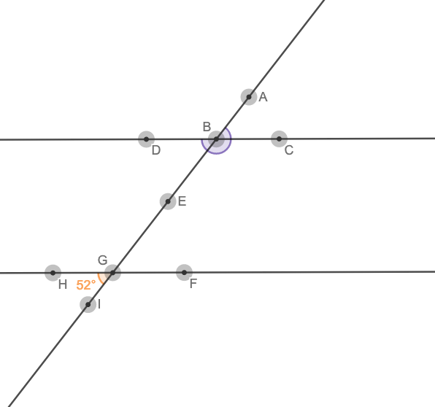
Level 2 - Find the missing angle measures in the red box.
∠ABC =
∠ABD =
∠DBE =
∠CBE =
∠FGI =

Slide 3
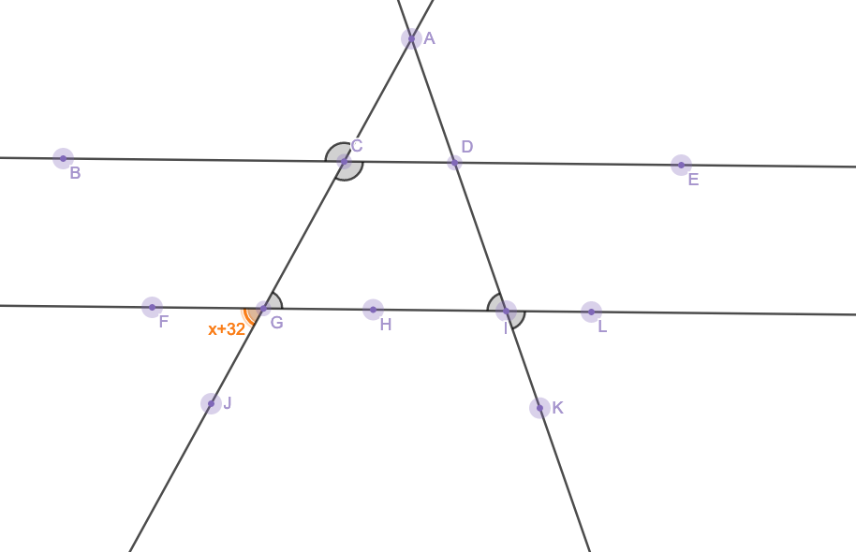
Level 3 - Solve for x and missing angle measures.
X =
∠DCG =
∠LIK =
∠CGH =
∠FGJ =
∠ACB =

Slide 4
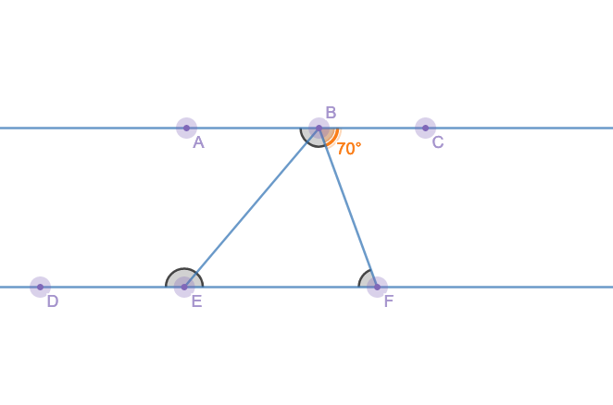
Level 4 - Solve for x and missing angle measures.
X =
∠DEB =
∠CBF =
∠BFE =
∠BEF =
∠ABE =
∠FBE =

